Slide 1
THE LOOK
Business case

Slide 2
Table of contents
01
02
03
04
Current situation
Model proposition
Repurchase analysis
Catboost model and feature importance
Deployment and prod
Conclusions and recommendations
Arquitecture design and deployment

Slide 3
01
Current situation

Slide 4
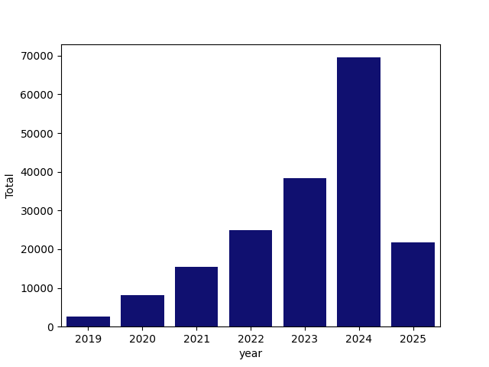
Evolution of traffic with purchase intent

Slide 5
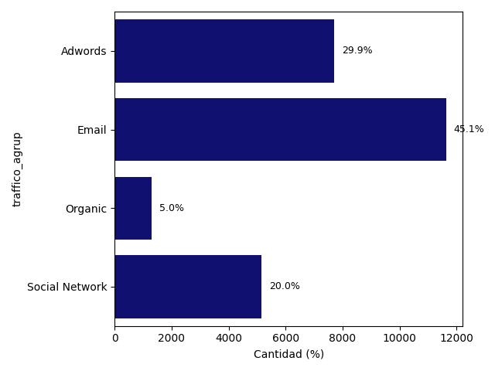
Where does the traffic come from?

Slide 6
Ecommerce traffic - repurchase ratio
Repurchase | Traffic organic | Social networks | Email | Adds | Total
No | 7.5% | 26.9% | 26.6% | 39.0% | 100.0%
Sí | 8.3% | 27.3% | 24.1% | 40.3% | 100.0%
 | Users
year \ PO | 1 | 2 | 3 | 4
2019 | 408 | 10 | 0 | 0
2020 | 1339 | 29 | 0 | 0
2021 | 2581 | 60 | 0 | 0
2022 | 4037 | 111 | 4 | 0
2023 | 6209 | 260 | 4 | 0
2024 | 10478 | 674 | 38 | 0
2025 | 3260 | 183 | 15 | 2
average | 4044.571 | 189.571 | 8.714 | 0.286

Slide 7
02
Model proposition

Slide 8

Repurchase model and variables
Predictive model of repurchase probability
User variables
User behavior variables
Product variables
Purchase order variables
Event variables (interactions) in e-commerce
AUC: 0.85

Slide 9
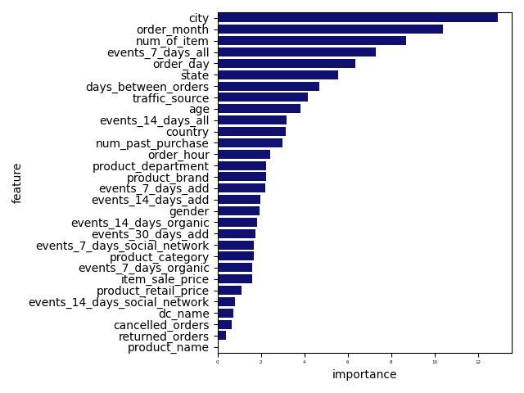
Feature importance

Slide 10
Customers with high repurchase probability in the next 60 days.
threshold :0.082
68 customers
age | gender | state | city | country | traffic_source | probabilidad
12 | M | ParaÃ­ba | JoÃ£o Pessoa | Brasil | Search | 0.2954598
19 | F | Henan | Shan Tou | China | Facebook | 0.137097665
19 | M | Fujian | Dongguan | China | Organic | 0.097524016
21 | M | ParÃ¡ | Barcarena | Brasil | Display | 0.870588235
23 | M | Heilongjiang | Lan'Zhou | China | Organic | 0.395635278
24 | M | California | Galt | United States | Facebook | 0.498667971
24 | M | Nordrhein-Westfalen | Krefeld | Germany | Email | 0.418657003
25 | F | California | Rancho Cucamonga | United States | Search | 0.336648392
26 | F | CataluÃ±a | Palafolls | Spain | Search | 0.627923949
26 | F | Guangdong | Guangzhou | China | Organic | 0.438292895
27 | M | Hebei | Handan | China | Email | 0.250782272
27 | M | Mato Grosso | TangarÃ¡ da Serra | Brasil | Search | 0.77903071
32 | M | Texas | Dallas | United States | Search | 0.452469128
34 | M | Sichuan | Yichun | China | Organic | 0.966666667
35 | F | CataluÃ±a | CornellÃ de Llobregat | Spain | Organic | 0.584879032
39 | M | Liaoning | Putian | China | Facebook | 0.502917188
40 | M | New Jersey | Evesham | United States | Search | 0.240319773
40 | M | ParanÃ¡ | Jacarezinho | Brasil | Search | 0.720260089
43 | F | England | Winterton | United Kingdom | Search | 0.79727712

Slide 11
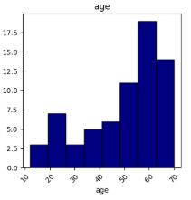
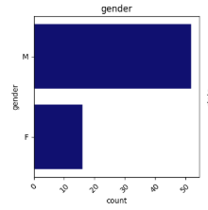
Characteristics of customers that repurchase

Slide 12
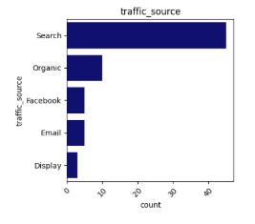
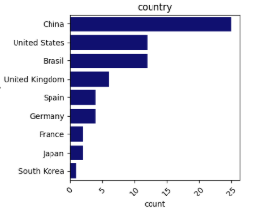
Characteristics of customers that repurchase

Slide 13
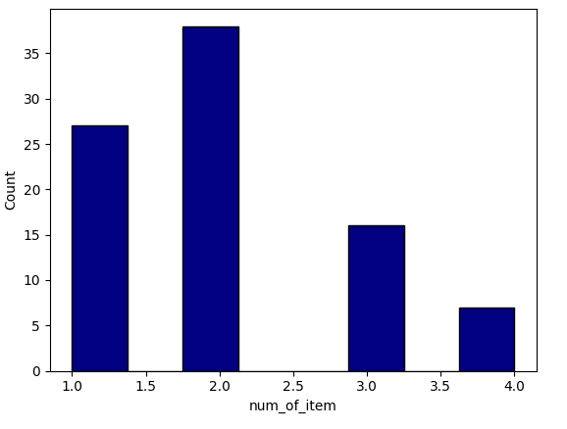
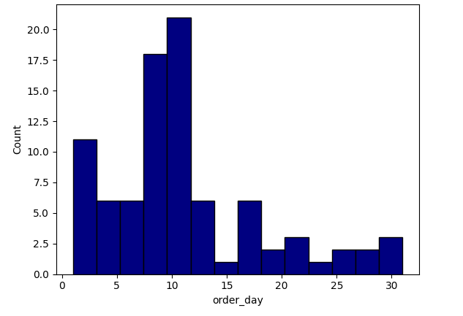
Characteristics of customers that repurchase

Slide 14
03
Deployment & Production

Slide 15
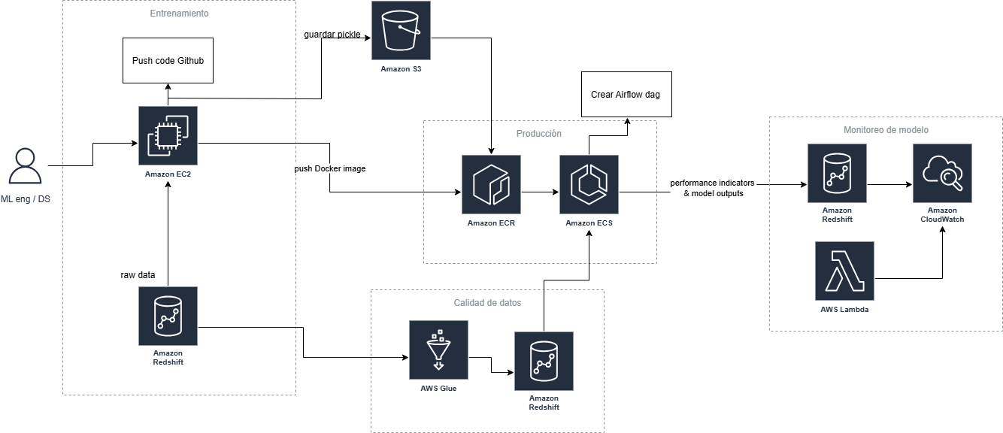

Deployment architecture in AWS

Slide 16
04
Conclusions & Recomendations

Slide 17
Conclusions y recomendations
Main factors found to affect repeat purchases:
Geographic factors (City, Country)
Number of items
currently purchased Interactions on the e-commerce site in the last 7 days
Brand presence in the user's mind:
Ads, social media, and email. 1% average decrease in organic traffic.
It is suggested to optimize e-commerce SEO by taking into account the variables of the repurchase model.
Few items per purchase
69.7% of purchases included only one item, 20% included two items, and 4.5% included more than two items.
It is suggested that a recommendation system be implemented to improve the user experience (more items per purchase and more repeat purchases per user).

